Slide 1
Tree Based Algorithms
Saravana

Slide 2
Decision Tree
A decision tree is a flowchart-like structure in which each internal node represents a “test” on an attribute (e.g. whether a coin flip comes up heads or tails), each branch represents the outcome of the test, and each leaf node represents a class label (decision taken after computing all attributes). The paths from root to leaf represent classification rules.
Why Use Decision Tree?

Slide 3
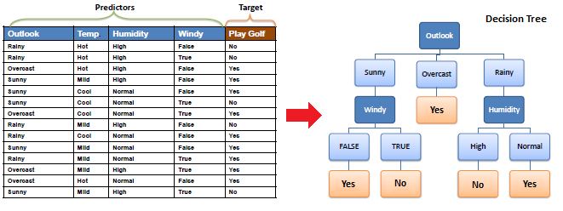

Slide 4
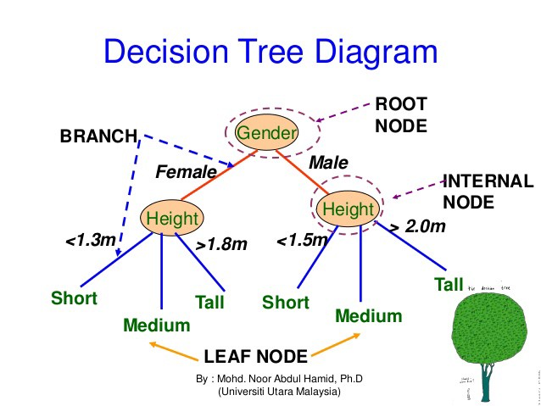

Slide 5
Common terms used with Decision trees
Root Node
Splitting
Decision Node
Leaf/Terminal Node
Pruning
Branch/Sub-Tree
Parent and Child Node

Slide 6
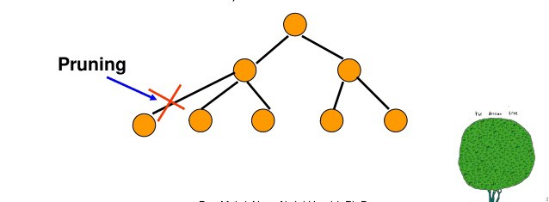
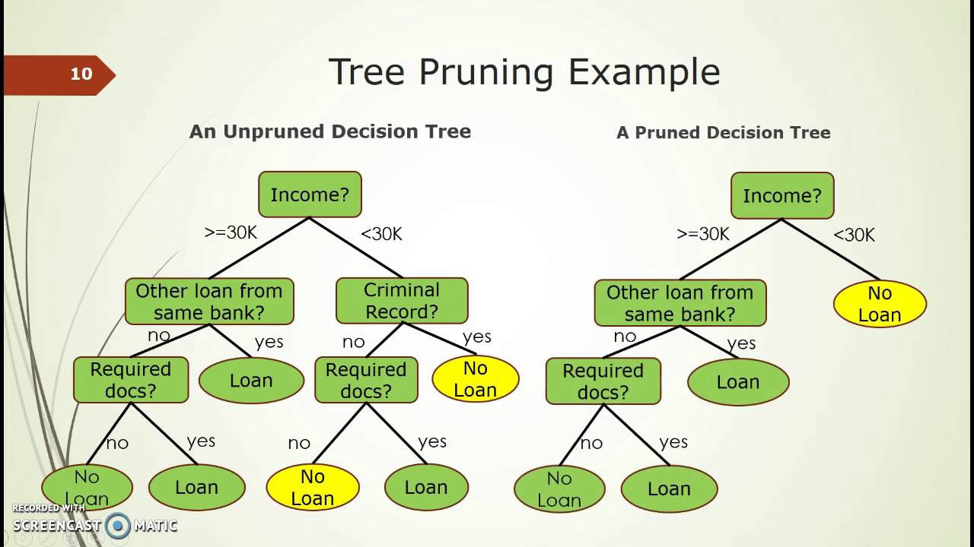
Pruning

Slide 7
Types
Categorical Variable Decision Tree
Continuous Variable Decision Tree
Regression trees are used when dependent variable is continuous. Classification Trees are used when dependent variable is categorical
Both the trees follow a top-down greedy approach known as recursive binary splitting

Slide 8
Okay so how to build this?
CART (Classification and Regression Trees) → uses Gini Index(Classification) as metric.
ID3 (Iterative Dichotomiser 3) → uses Entropy function and Information gain as metrics.

Slide 9
Gini Index
The Gini coefficient, sometimes called Gini index, or Gini ratio, is a measure of statistical dispersion intended to represent the income or wealth distribution of a nation's residents, and is the most commonly used measurement of inequality
It ranges from 0 to 1, where 0 means perfect equality and 1 means no equality

Slide 10
Information Gain
Determine the attribute that best classifies the training data
Use this attribute at the root of the tree
Repeat this process at for each branch
So how do we choose the best attribute - attribute with the highest information gain in ID3
If all examples are positive or all are negative then entropy will be zero i.e., low.
If half of the examples are of positive class and half are of negative class then entropy is one i.e., high.

Slide 11
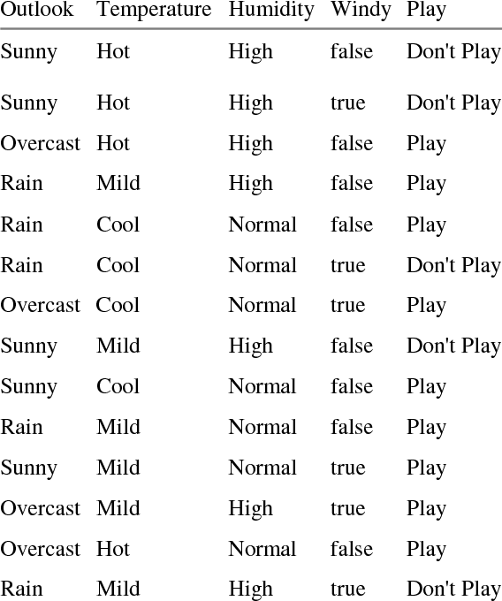
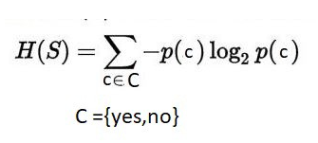


Slide 12
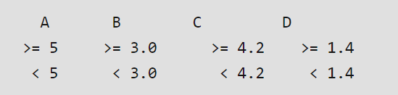
INDEX | A | B | C | D | E
1 | 4.8 | 3.4 | 1.9 | 0.2 | positive
2 | 5 | 3 | 1.6 | 1.2 | positive
3 | 5 | 3.4 | 1.6 | 0.2 | positive
4 | 5.2 | 3.5 | 1.5 | 0.2 | positive
5 | 5.2 | 3.4 | 1.4 | 0.2 | positive
6 | 4.7 | 3.2 | 1.6 | 0.2 | positive
7 | 4.8 | 3.1 | 1.6 | 0.2 | positive
8 | 5.4 | 3.4 | 1.5 | 0.4 | positive
9 | 7 | 3.2 | 4.7 | 1.4 | negative
10 | 6.4 | 3.2 | 4.7 | 1.5 | negative
11 | 6.9 | 3.1 | 4.9 | 1.5 | negative
12 | 5.5 | 2.3 | 4 | 1.3 | negative
13 | 6.5 | 2.8 | 4.6 | 1.5 | negative
14 | 5.7 | 2.8 | 4.5 | 1.3 | negative
15 | 6.3 | 3.3 | 4.7 | 1.6 | negative
16 | 4.9 | 2.4 | 3.3 | 1 | negative

Slide 13
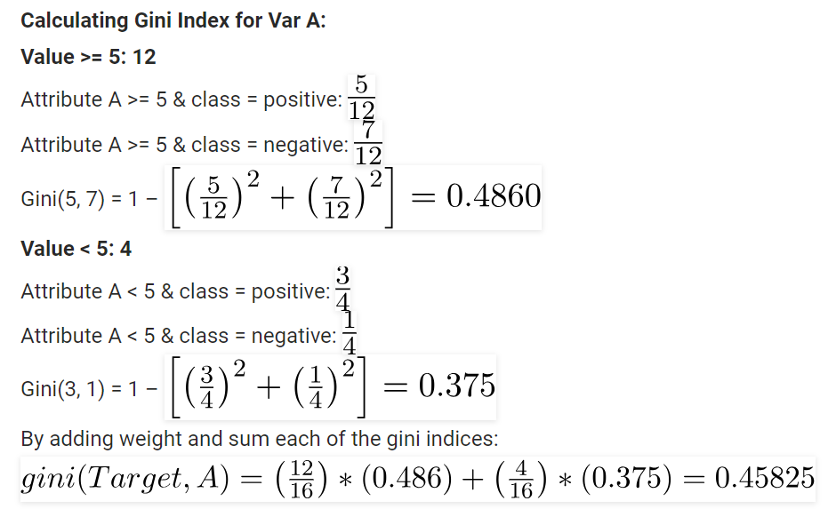

Slide 14
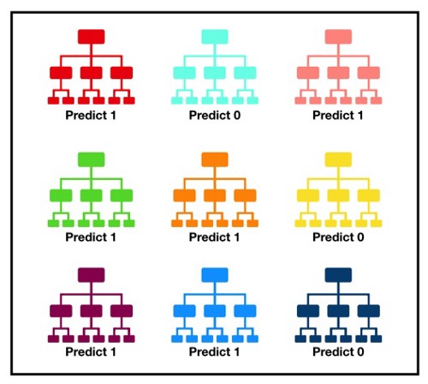
Random Forest
It consists of a large number of individual decision trees
Each individual tree in the random forest spits out a class prediction and the class with the most votes becomes our model’s prediction
Instead of the original training data,
we take a random sample of size N with replacement
In random forest, we end up with trees that are not only trained on
different sets of data but also use different features to make decisions
It uses bagging and feature randomness when building each individual tree to try to create an uncorrelated forest of trees

Slide 15
ENSEMBLE LEARNING
Main causes of difference in actual and predicted values are noise, variance, and bias.
Ensemble helps to reduce these factors (except noise, which is irreducible error)

Slide 16
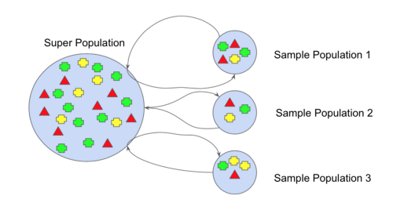
BOOTSTRAPPING
Bootstrap refers to random sampling with replacement

Slide 17
BAGGING
Bootstrap Aggregation (or Bagging for short)
Difference between Bagging & Random Forest

Slide 18
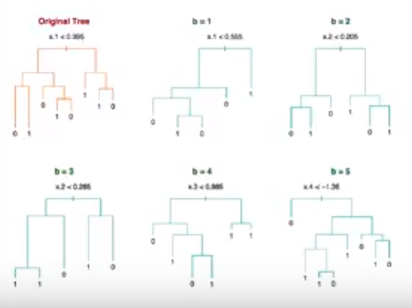
BOOSTING
Boosting refers to a group of algorithms that utilize weighted averages to make weak learners into stronger learners
Out of Bag Error
Just as we sometimes develop life skills by learning from our mistakes, we can train our model to learn from the errors predicted and improvise the model’s prediction and overall performance

Slide 19
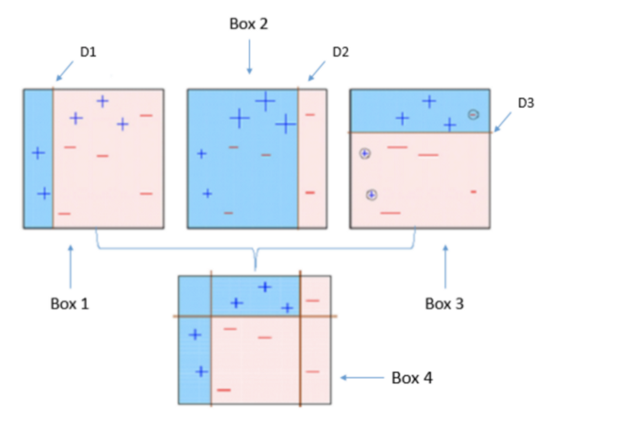
AdaBoost
Its built with Decision Stumps
Weighting the observations
Putting more weight on difficult to classify instances and less weight on those already handled well.
New weak learners are added sequentially and making a good prediction

Slide 20
Gradient Boosting
Most of the magic is described in the name: “Gradient” plus “Boosting”.
A loss function to be optimized.
A weak learner to make predictions.
An additive model to add weak learners to minimize the loss function.
The gradient is nothing, but the partial derivative of our loss function - so it describes the steepness of our error function

Slide 21
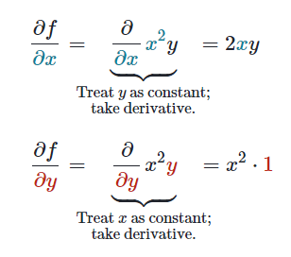
Calculating Gradient Descent
Derivative
{df}/{dx} - Interpret dx, as "a very tiny change in x“ and df as "a very tiny change in the output of f", where it is understood that this tiny change is whatever results from the tiny change dx, x to the input
Partial Derivative
For a multivariable function, like f(x, y) = x^2*y computing partial derivatives
The reason for a new type of derivative is that when the input of a function is made up of multiple variables, we want to see how the function changes as we let just one of those variables change while holding all the others constant
Partial Derivative of the Loss Function

Slide 22
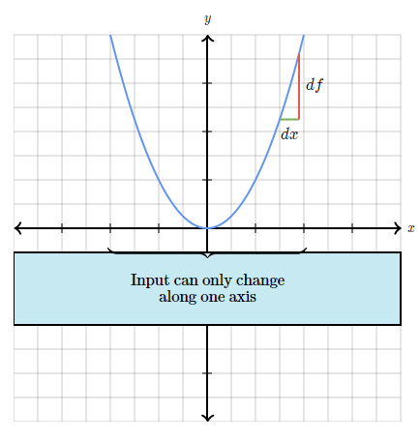
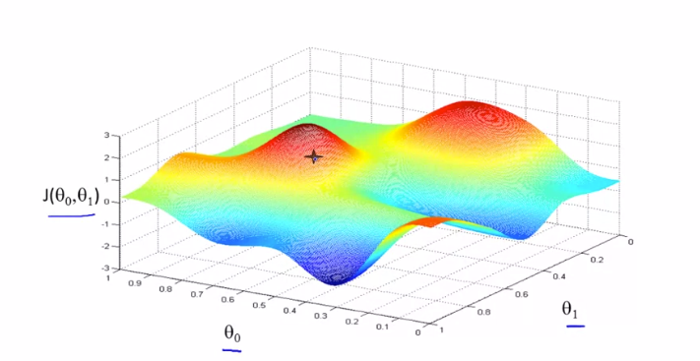


Slide 23
Derivative
Slope the rate of change in x and the rate of change in y

Slide 24
XGBoost
Gradient Boosting algorithm also called gradient boosting machine including the learning rate.
Stochastic Gradient Boosting with sub-sampling at the row, column and column per split levels.
Regularized Gradient Boosting with both L1 and L2 regularization.

Slide 25
Which is the best, Bagging or Boosting?
Bagging and Boosting decrease the variance of your single estimate as they combine several estimates from different models. So the result may be a model with higher stability

Slide 26
Parameters Tuning
the number of iterations (i.e. the number of trees to ensemble),
the number of observations in each leaf,
tree complexity and depth,
the proportion of samples and
the proportion of features on which to train on.

